Slide 1

Beyond the seas – v2
Presented by:
1805112 – Asif Haider
1805113 – KM Fahim Shahriyar
1805115 – Azizur Rahman Anik

Slide 2

REGISTER

Slide 3
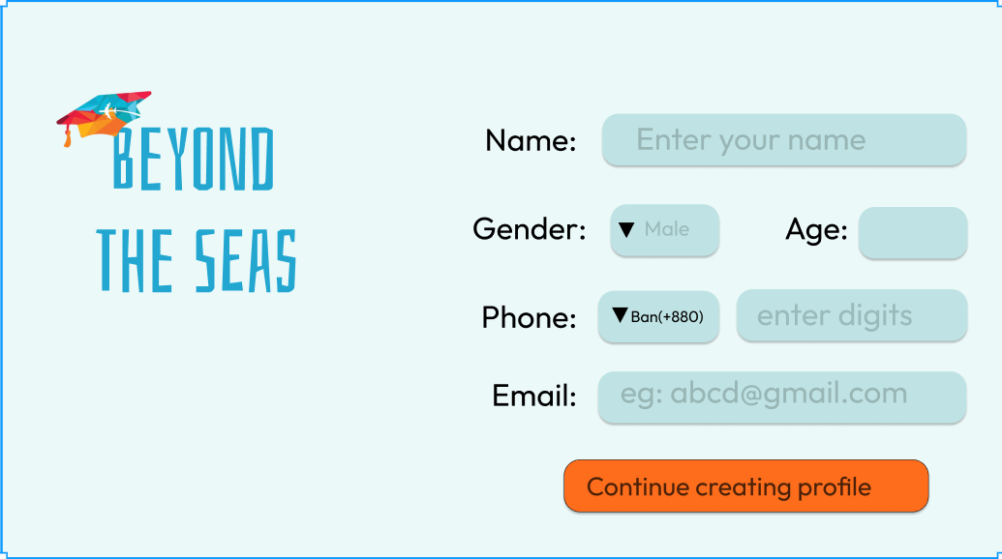
CREATE PROFILE(PERSONAL INFO)

Slide 4
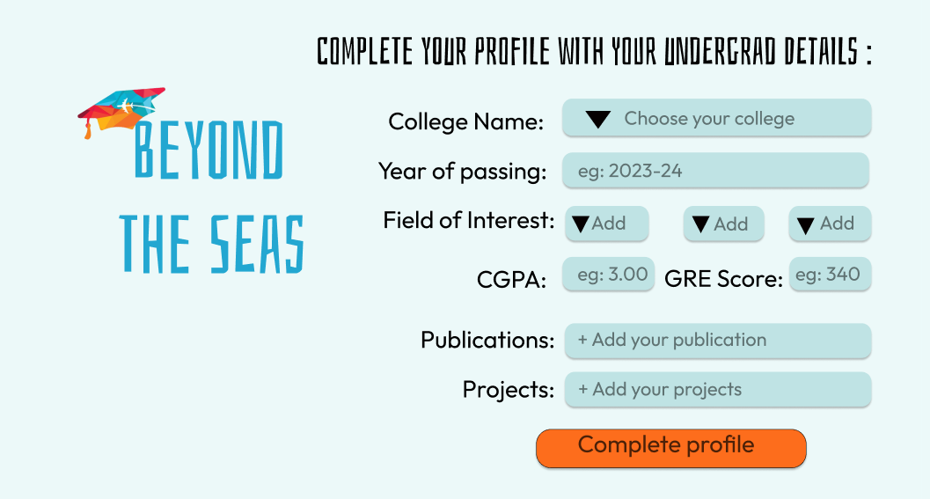
CREATE PROFILE(ACADEMIC INFO)

Slide 5
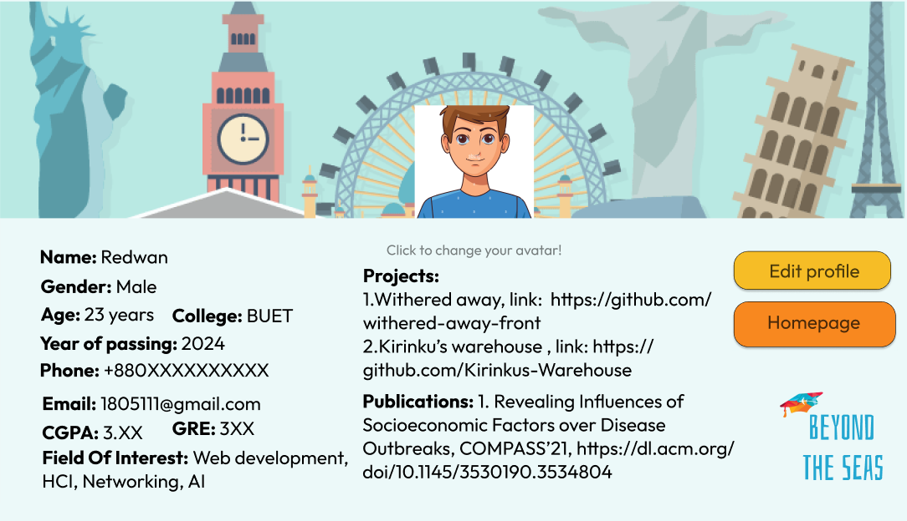
User Profile

Slide 6
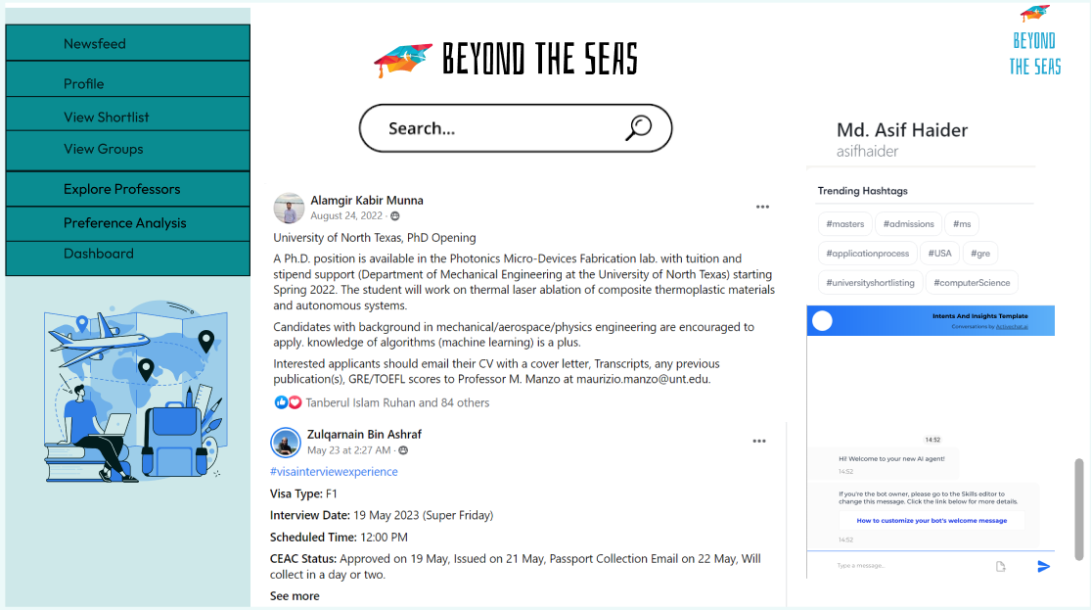
HOMEPAGE

Slide 7
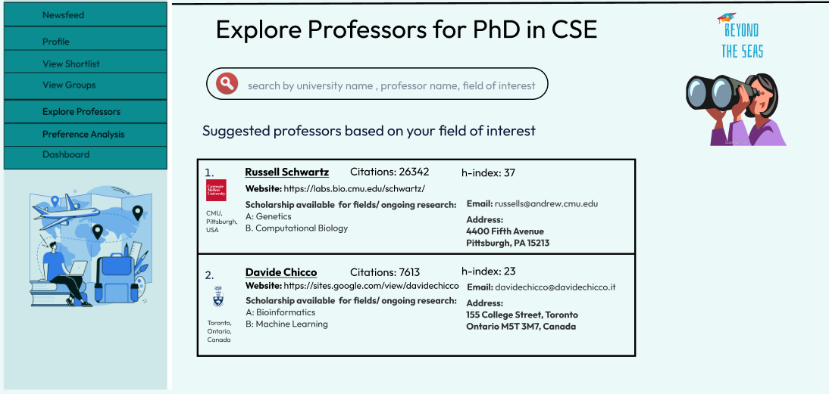
EXPLORE PROFESSOR

Slide 8
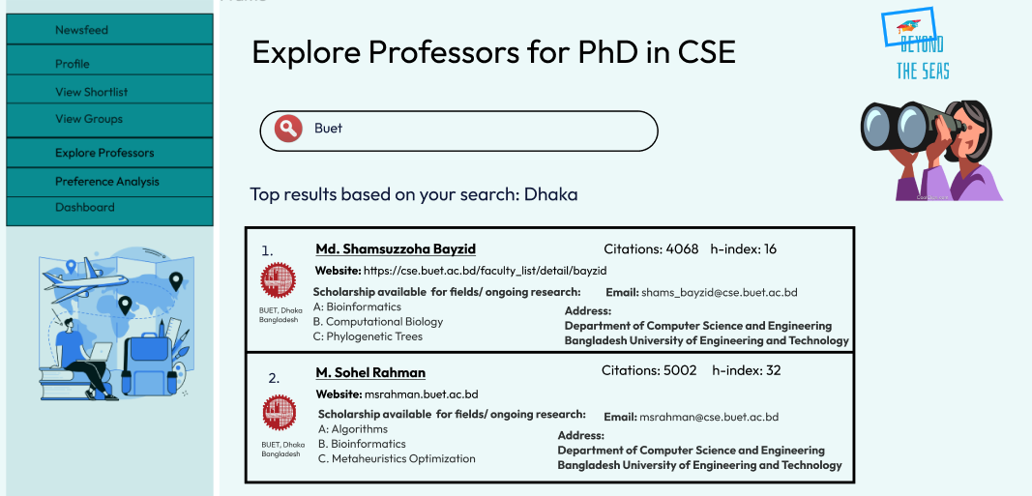
EXPLORE PROFESSOR(BY SEARCH)

Slide 9
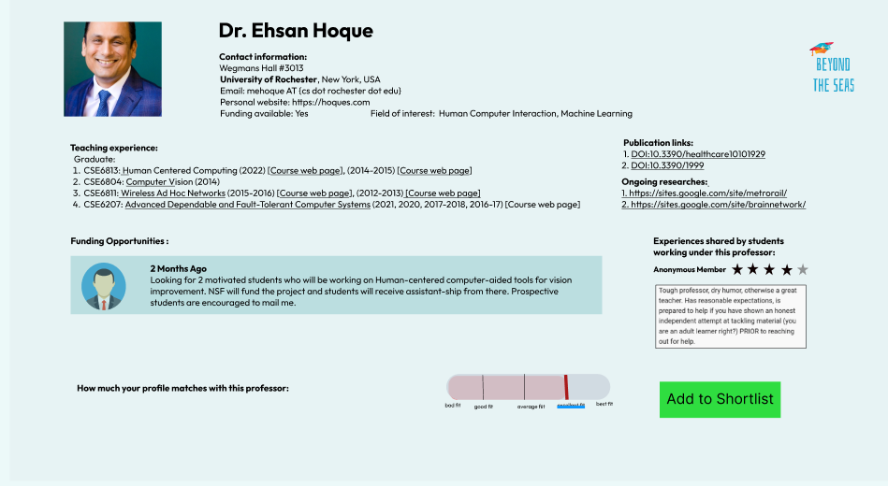
PROFESSOR DETAILS

Slide 10
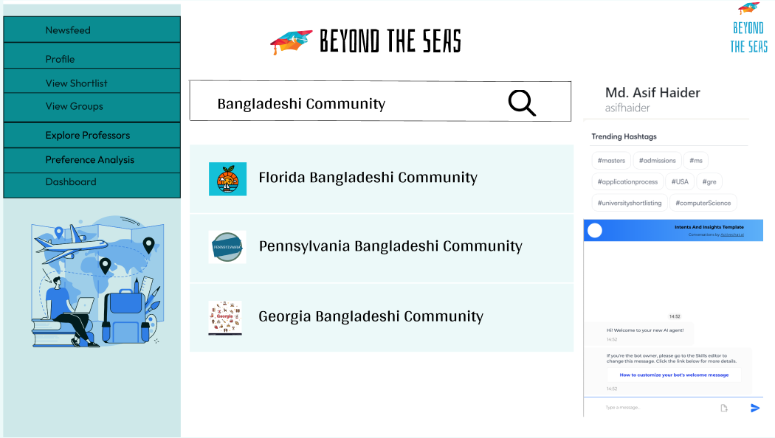
COMMUNITY SEARCH

Slide 11
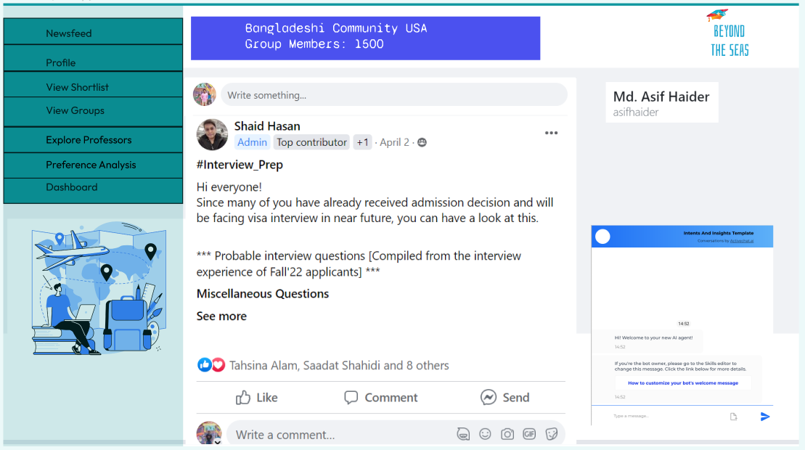
GROUP

Slide 12
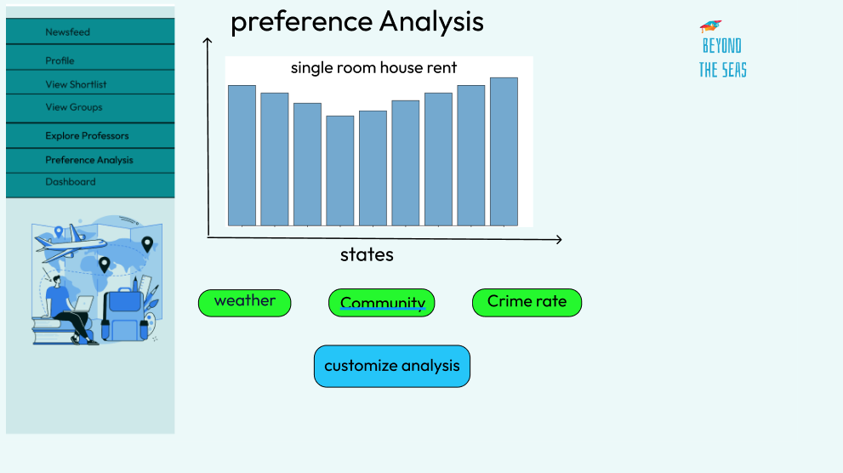
PREFERence ANALYTIcS

Slide 13
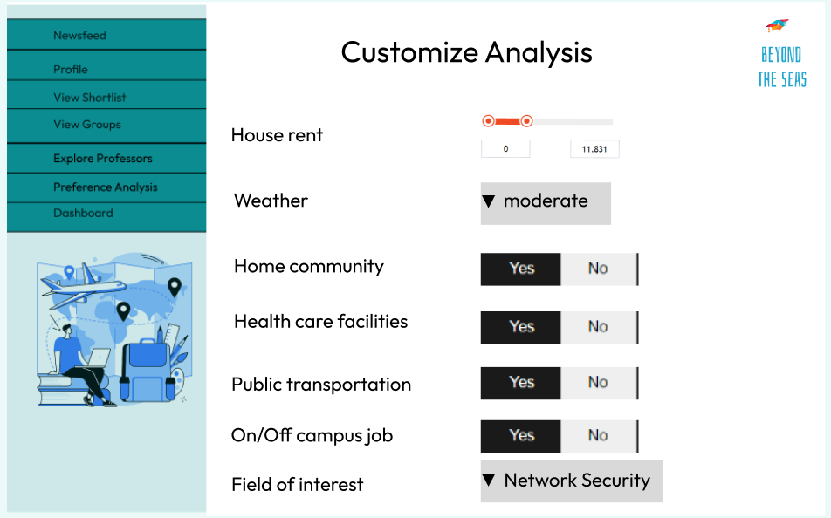
CUSTOMIZE Preference ANALYSIS

Slide 14
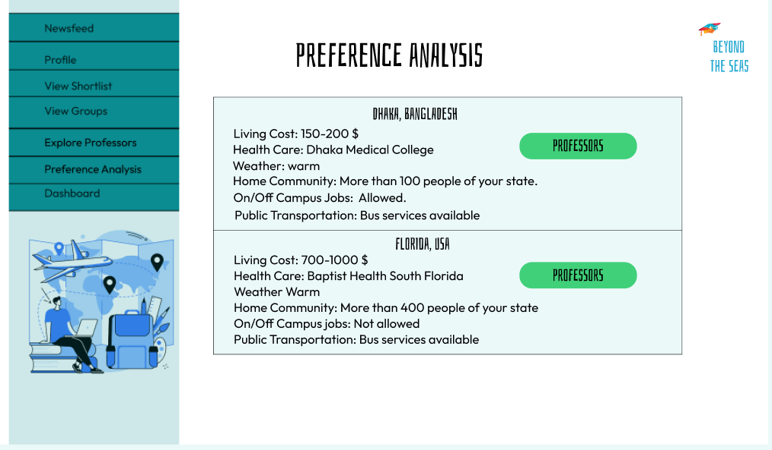
ANALYSIS RESULT

Slide 15
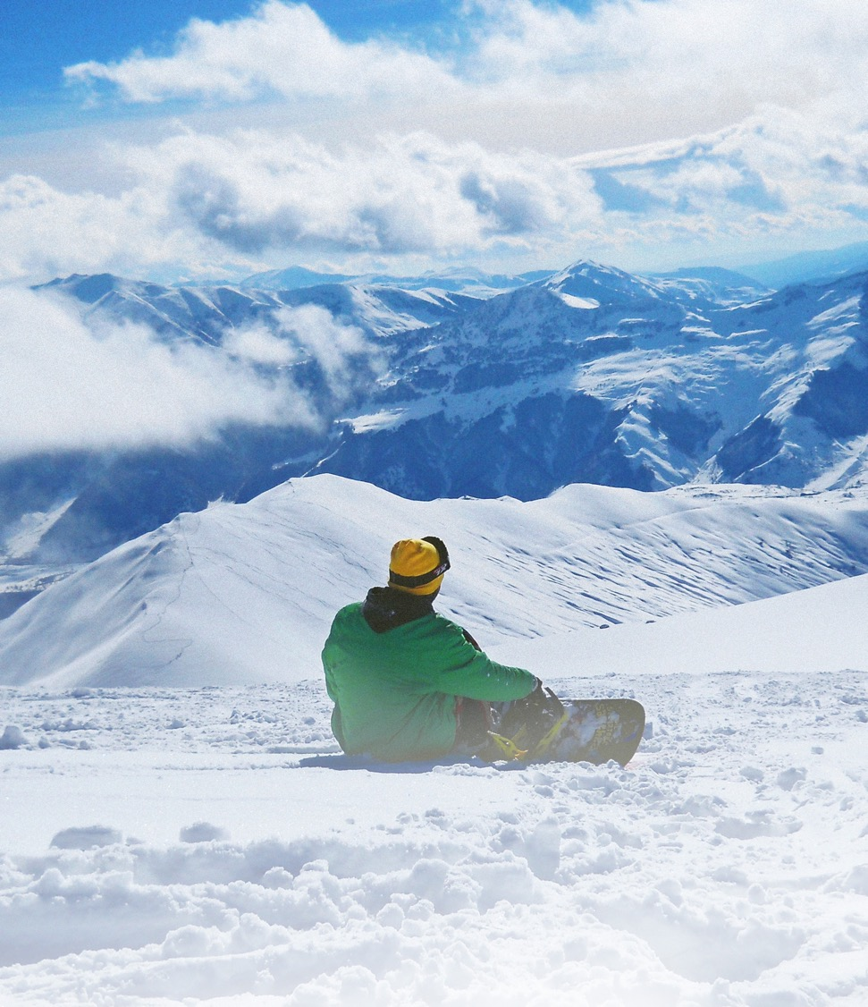
THANK YOU

